Slide 2
Community spirit ☺
Our community spirit event is aiming to bring our community together to raise money for our chosen charities.

Slide 3
Event Information
Saturday 8th July 2013, 9am to 11pm.
Russell Park, Bedford, MK40 3RH.
Admission Price: Adult prices £2.49
Child price £1.99

Slide 4
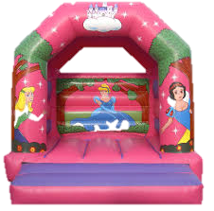
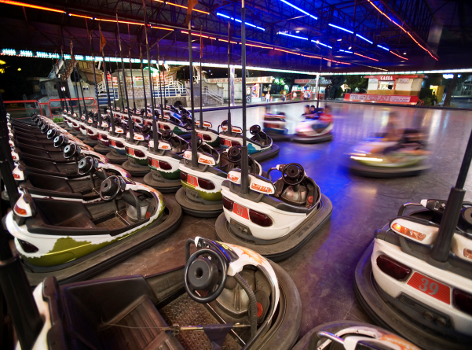
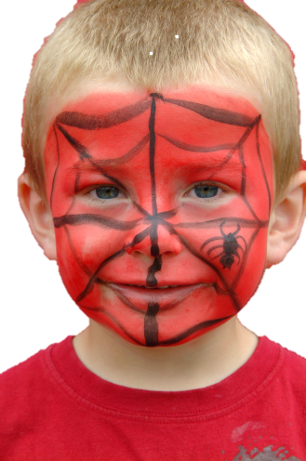
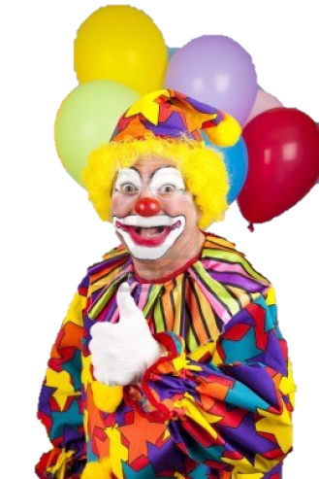
Bouncy castles
Bumper cars
Carousel
Face painting
Face painting kit
DJ
A magician
Clown balloon artist

Slide 5
Food and Drinks
There will be a variety of food and drinks available ranging from curries to Foster’s.

Slide 6
Contact us
Call us on 0800 666 786
Or email us at communityspiritevents.com

Slide 7
Are you a local charity?
If yes and you are interested please Email Communityspirit@bedford.com with the name of your charity, previous events(if applicable) and a brief explanation of what it wants to achieve and we will reply with more information about our event
Or call 0800 666 786

